Slide 1



KEYKING GROUP
An Israel Security Corporation

Slide 2


Integrated Security Solutions

Slide 3
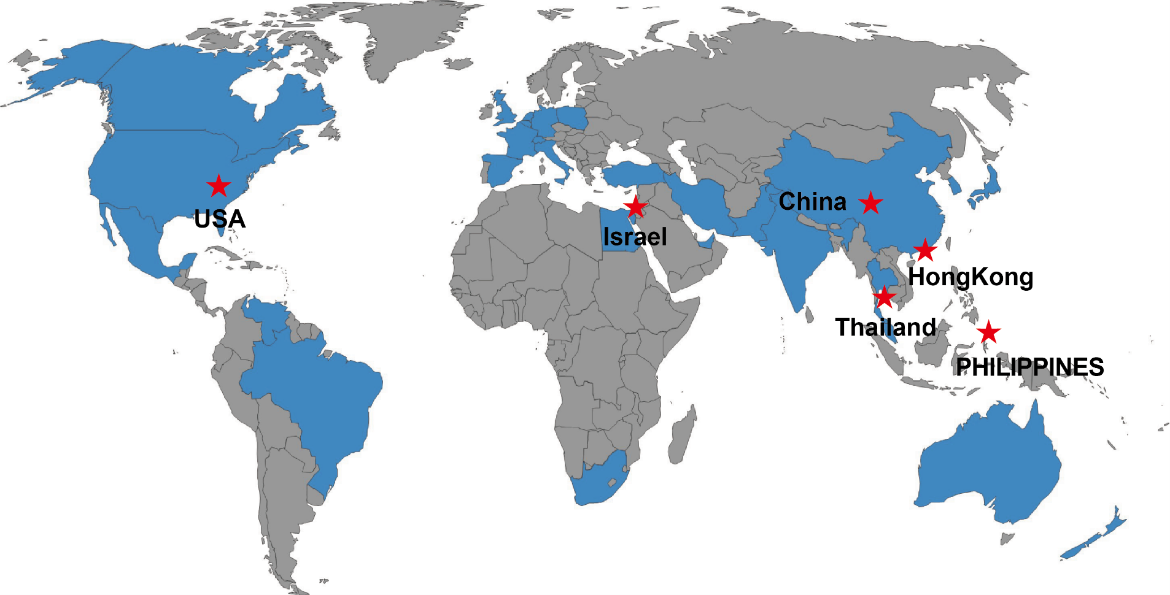
Branches

Slide 4
Integrated Security Solutions
Intelligent Building Management System
Access Control
Attendance
Visitor Management
Lift Control
Consumption System
Car Parking
Patrol Management

Slide 5
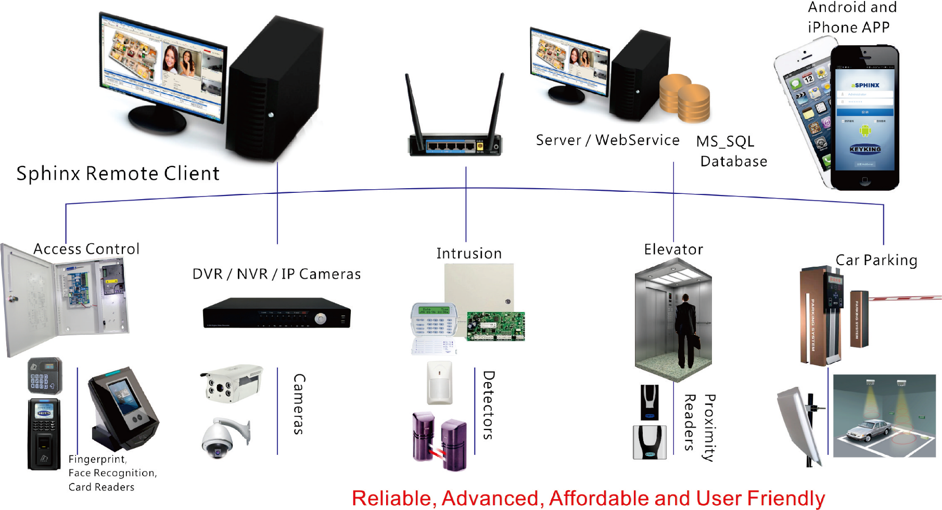
Integration System Diagram

Slide 6

Product Introduction
--Access Control

Slide 7
DPU3000POE
DPU3000POE Series
DPU3012POE, DPU3022POE, DPU3024POE, DPU3044POE, DPU3048POE

Slide 8
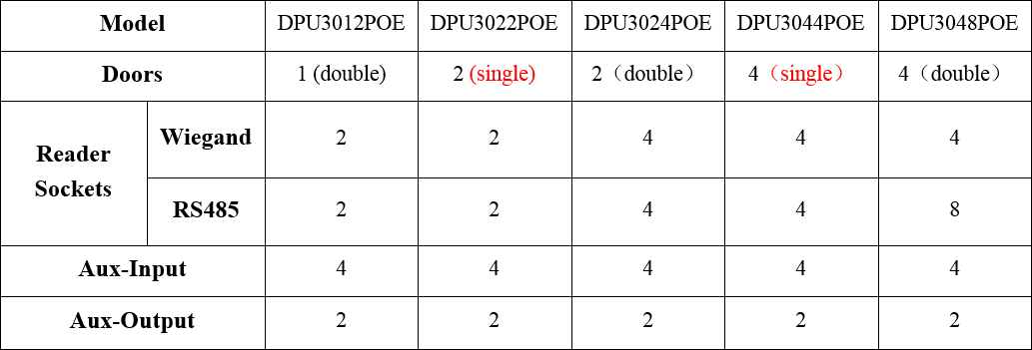
DPU3000POE, Flexible Models

Slide 9
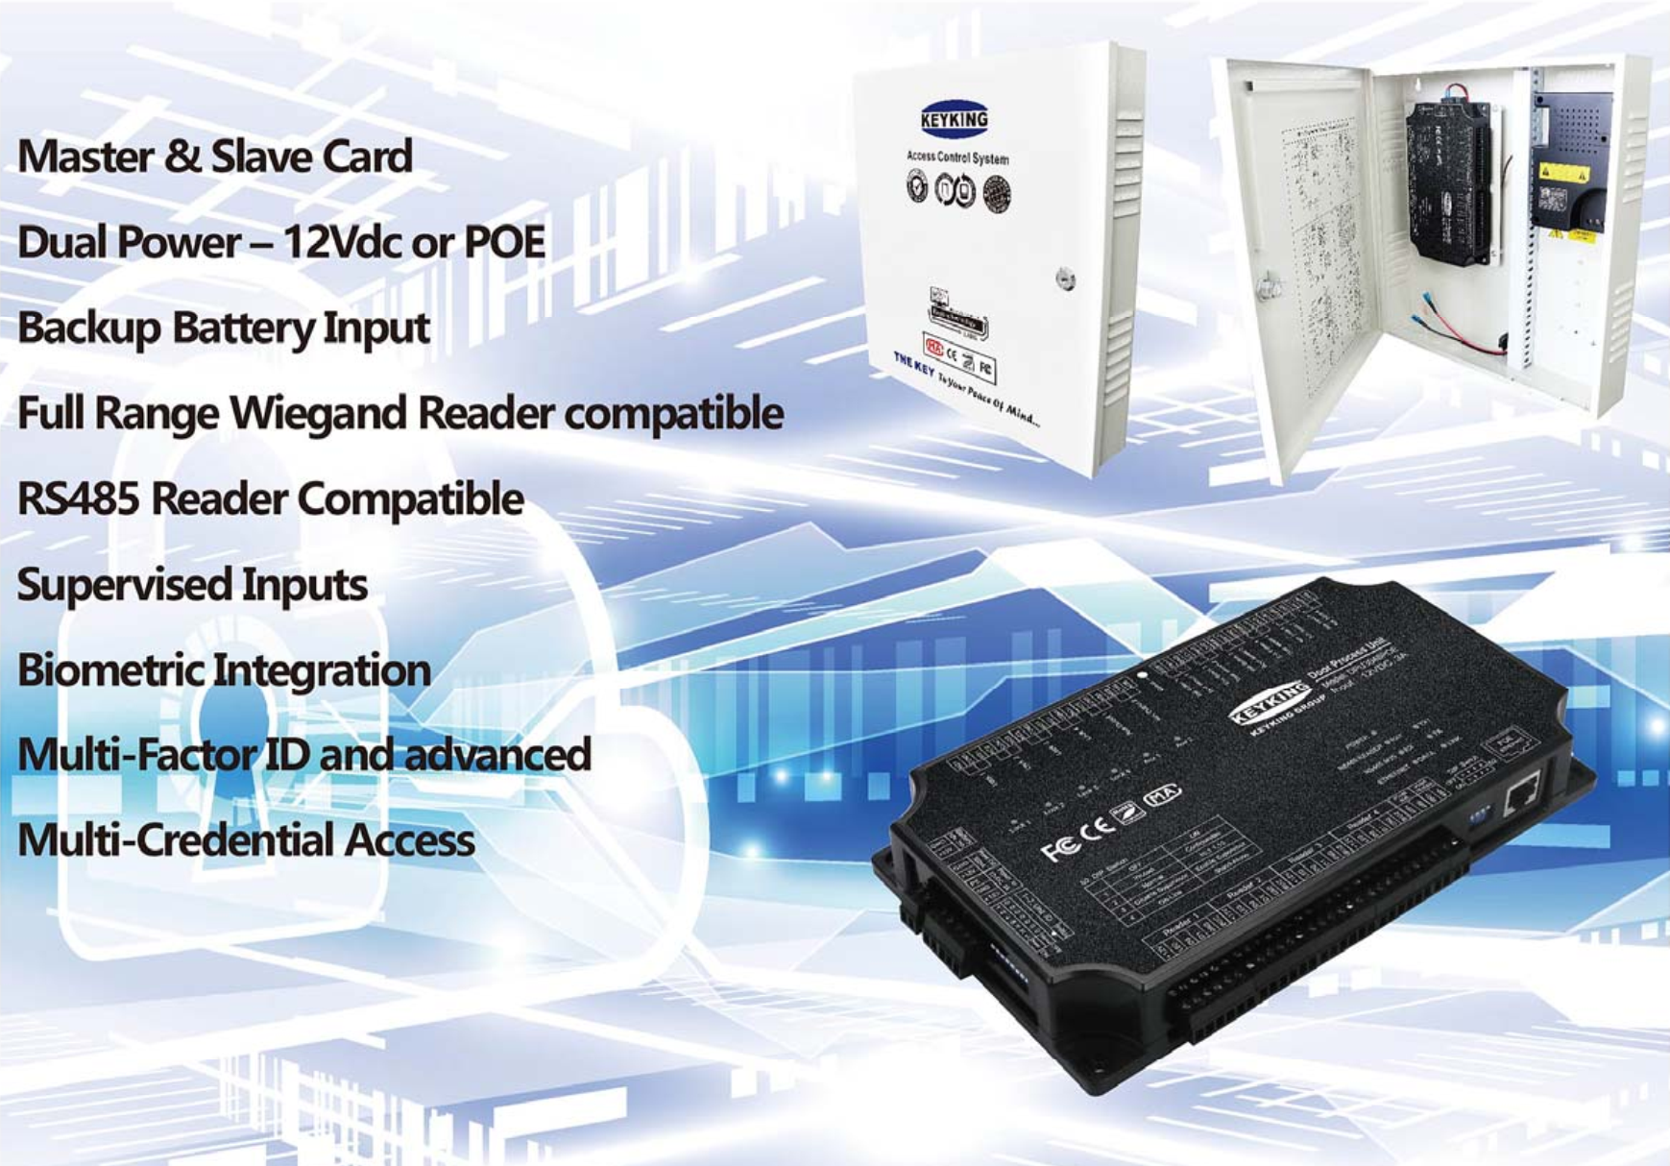
DPU3000POE

Slide 10
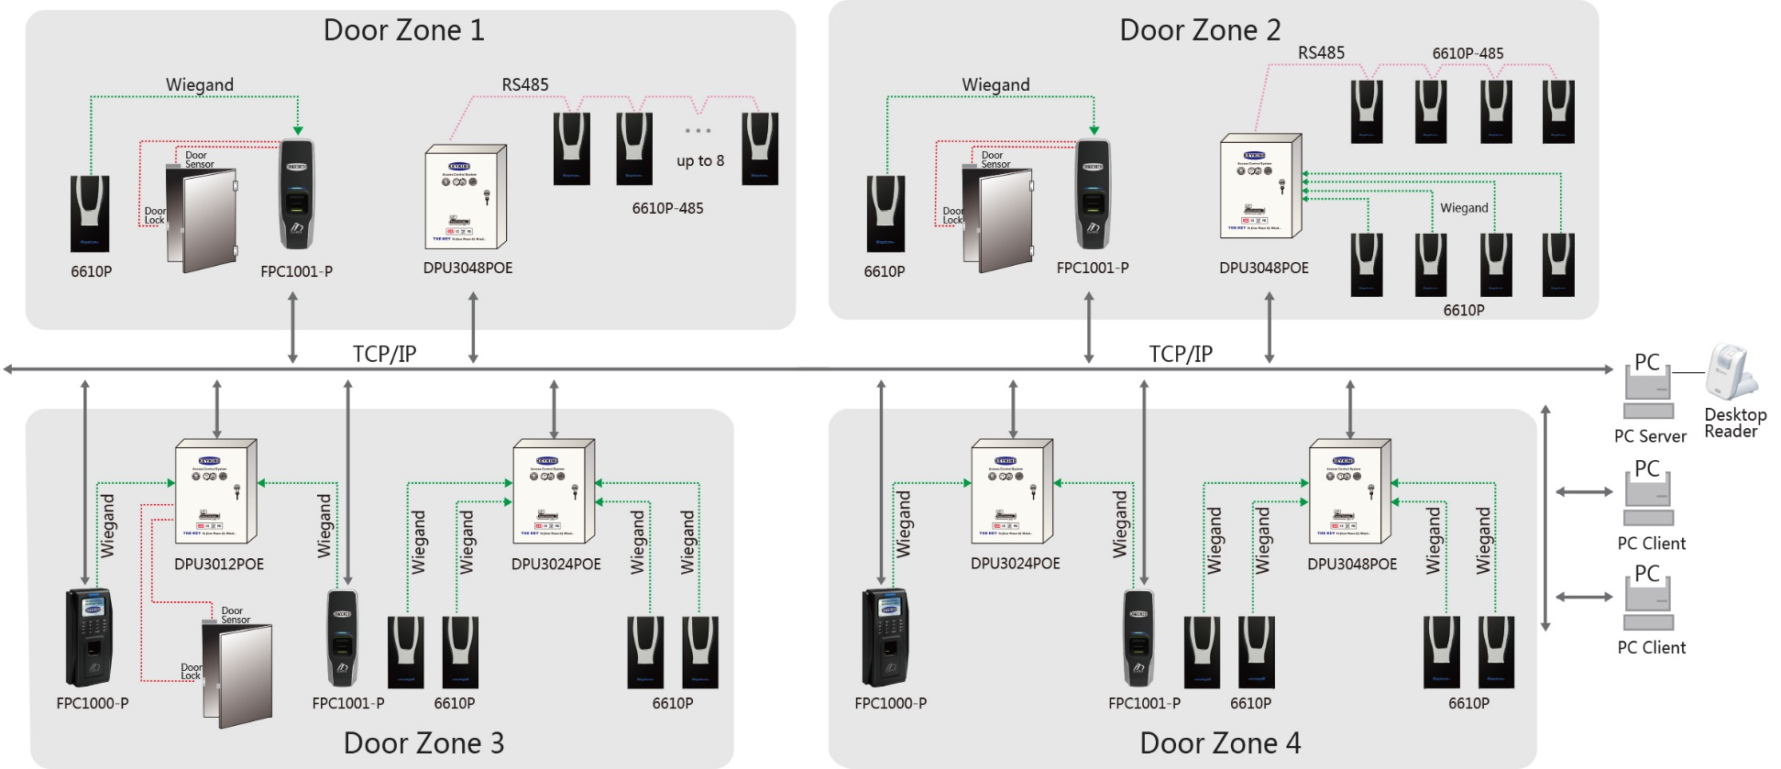
DPU3000POE
DPU3000POE management system architecture diagram

Slide 11
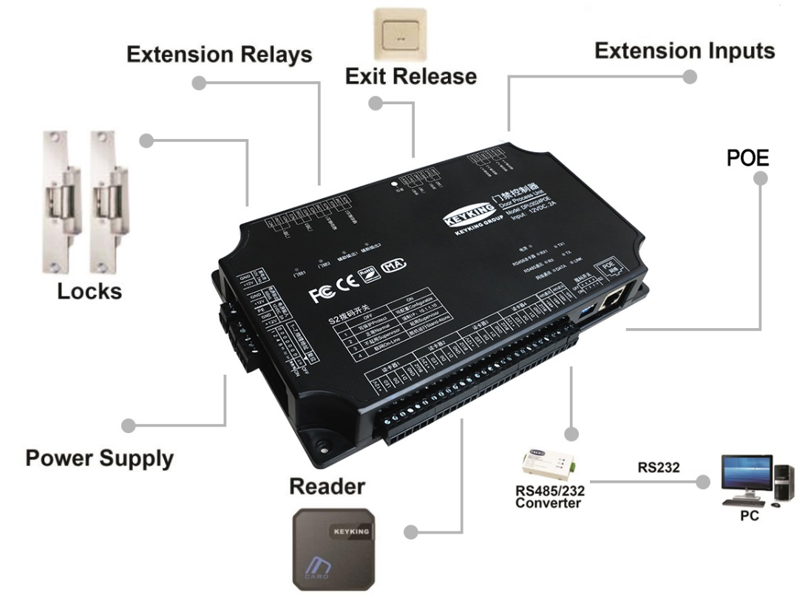
DPU3000POE
DPU3000POE series controller connection diagram

Slide 12
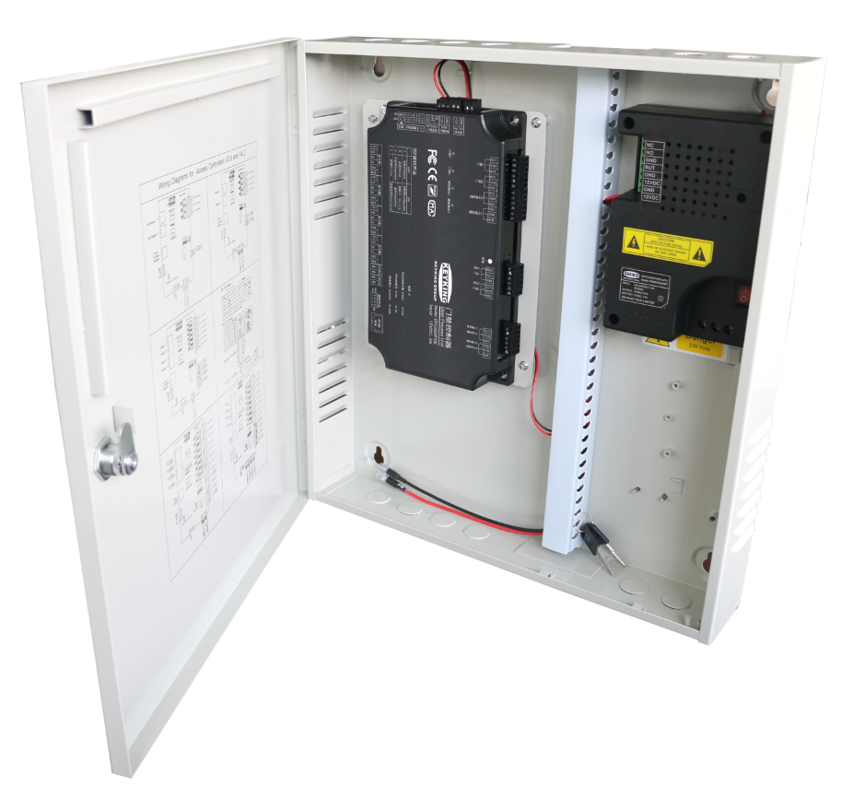




DPU3000POE
Flexile configuration, consist of 1\2\4 doors controller, and can be used freely
Advanced ARM M4 Processor, high speed response-100,000 credentials in 0.1 sec
Wiegand reader inputs- full range 24 to 72 bits, including proprietary readers.
Scenario based logical event and I\O based configuration with mathematical algorithms.

Slide 13
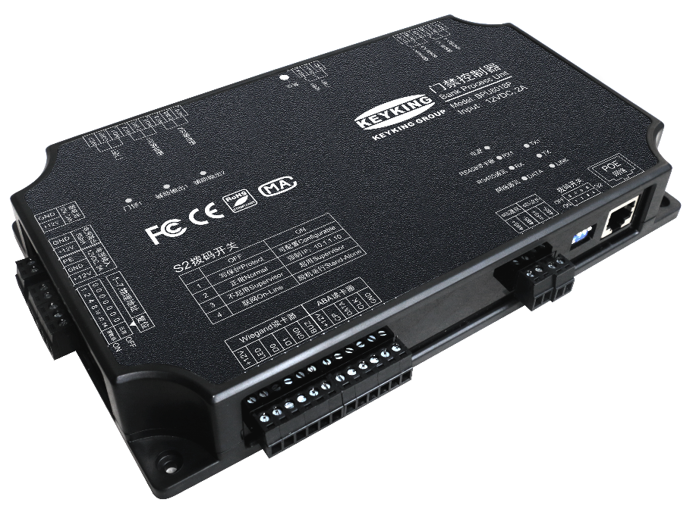



DPU3000POE
9 doors Access Options: Standard, Handicap, Multi-Factor ID, Anti PassBack, Supervisor-user, Multi-User-Group, Video-Verified by Guard, Manager, Emergency.
Sphinx-4 Integrated Security Software with CCTV, Intrusion, Biometric integration. Enterprise-Global and Remote access capabilities
Multi-Credentials, Multi-Factor ID and other High-Security options. Pay-Per-Swipe and many more capabilities.

Slide 14
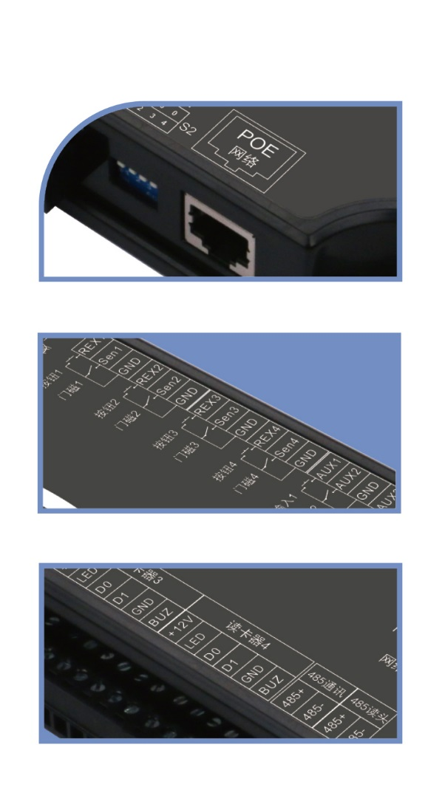



DPU3000POE, Stable, POE, RS485 reader
POE 803.11af, A&B format (End-span & Mid-span) with 600mA on board and backup battery connection
RS485 reader: encrypted readers compatibility, more security
On-Line and Off-Line modes:
On-Line: connected to the Sphinx software
Off-Line: Standalone, not connected to server

Slide 15
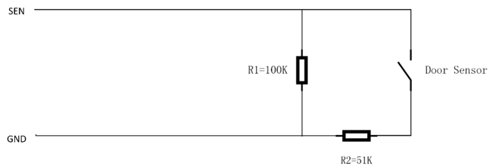


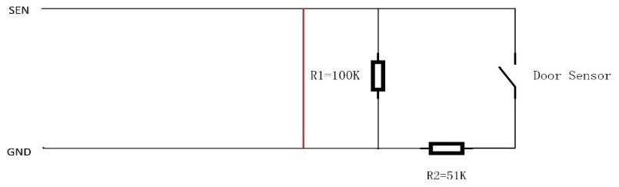

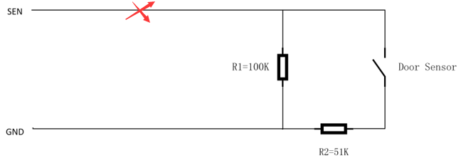
DPU3000POE, new features
8 Bytes card number, more security
4 Status with supervisor:
Open
Close
Cut
Short
Different Indictor on Reader:
Valid card
Invalid card
Door open too long
Door open forced

Slide 16
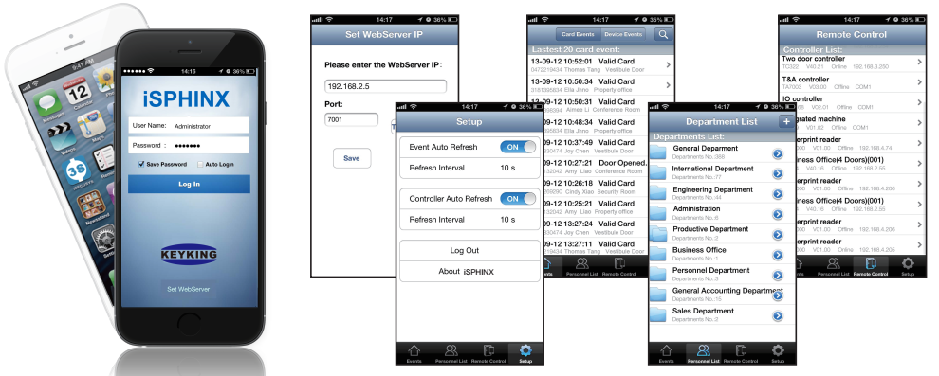
DPU3000POE, new features
Smart Phone APP
Compatible with Android , IOS
Management, Remote Control, Transactions...

Slide 17
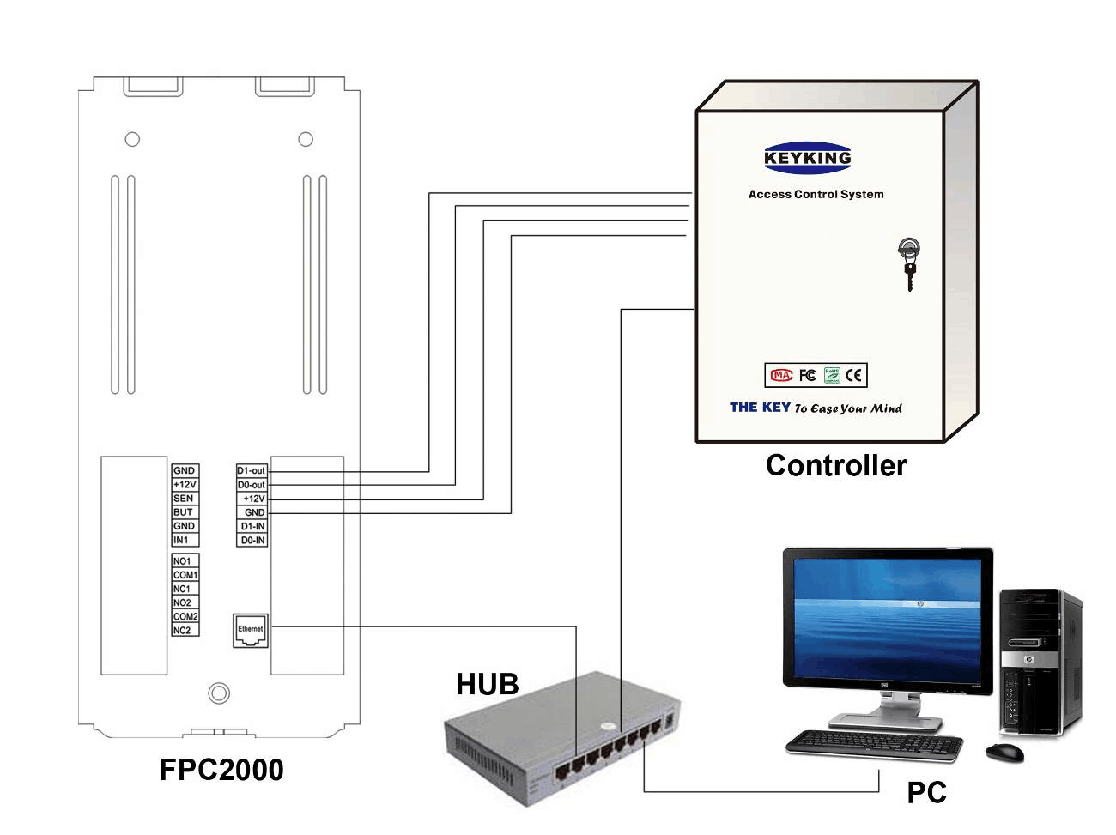
DPU3000POE, new features
PoE
POE, POE+
Backup battery: POE will offer a socket for backup battery.
Low Voltages protection: Power off during 10.6V, stop to charge during 13.8V.
Network based, 10/100 M.
DPU3024POE
PoE HUB

Slide 18



DPU3000POE, new features
Multi Database
Supports Oracle database, much more stable during huge system
Supports MS_SQL.
Supports MS_Access also, just for small system
Database

Slide 19

DPU3000POE, new features
Handicap card
Normal card: The door will keep open normal seconds, like 5 seconds.
Handicap card: The door will keep open longer, like 15 seconds.

Slide 20





DPU3000POE, new features
Multi Mode to open door
Card / PIN
Card + PIN
Card / FingerPrint
Card + FingerPrint
Multi cards: Up to 8 cards in short time, and release all cards after 8 seconds waiting
...

Slide 21
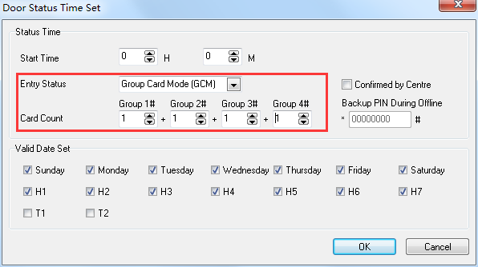
DPU3000POE, new features
Groups cards to open the door
Up to 4 groups
Several cards of each group

Slide 22

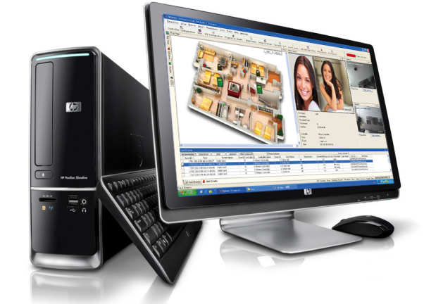
DPU3000POE, new features
Confirm by Monitor centre
Only confirmed by centre, then door will be open.
Special for Bank Money warehouse

Slide 23
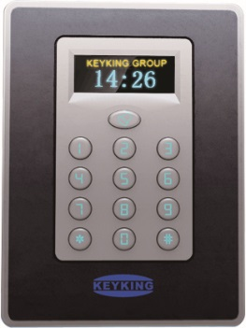

DPU3000POE, new features
Private PIN
Everybody will have a private PIN: 4 to 8 digitals
Private PIN will work as same as his card
System will show his name when he use his PIN

Slide 24


DPU3000POE, new features
Email notification
Up to 3 pcs target email box for every transaction
System will send email to these email box when the setting events happen.

Slide 25
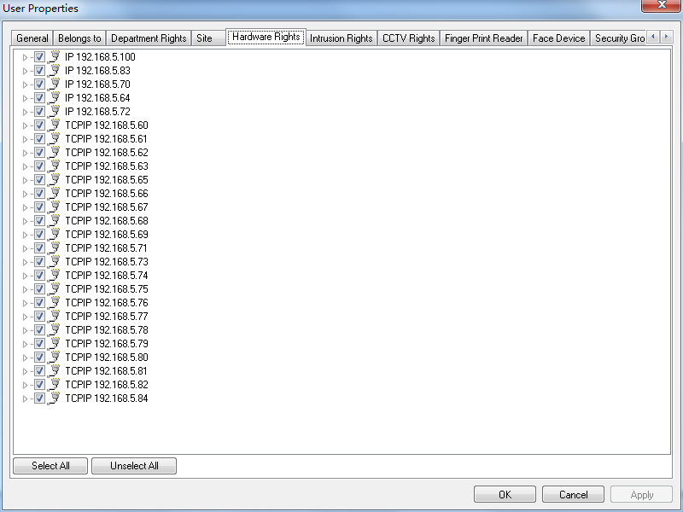
DPU3000POE, new features
Different view in different client
Same view for some clients
Different view for each client if you want
Only show these panels which is connected to this PC.

Slide 26
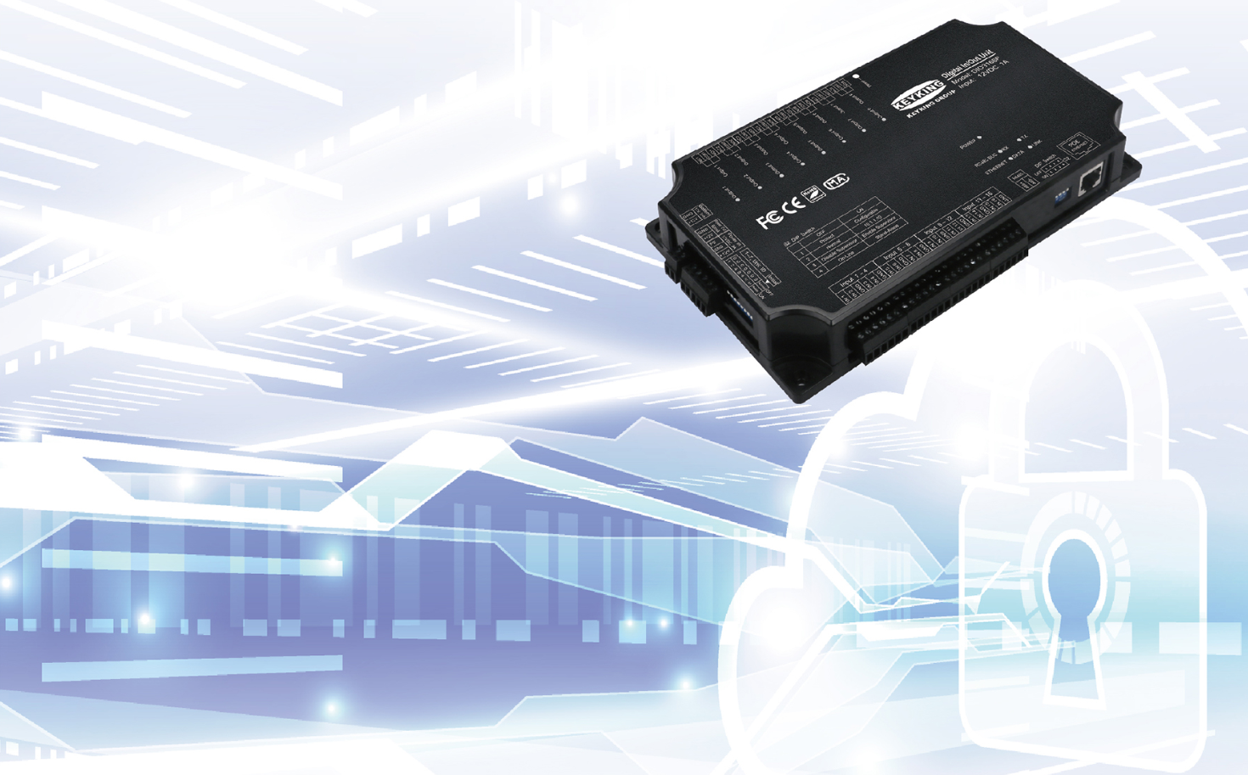
DIO3168P
Network-type Input and Output
POE Power Supply
Output Multiple Schedules
Programmable
Input Reverse Overvoltage Protection

Slide 27
Thank you！

